Slide 1





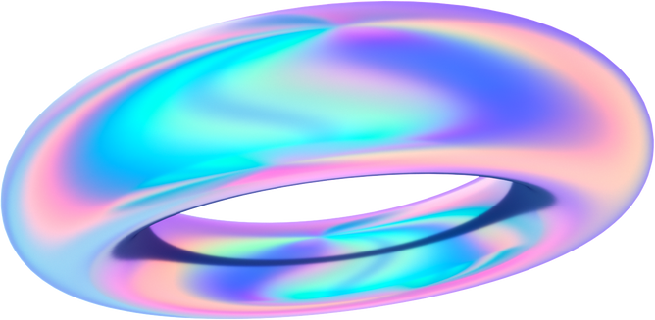

Rajeswari Vedachalam Govt Arts & Science College Chengalpattu
Department of Computer science
Early Prediction for
Chronic kidney disease detection
Team members :
Sneha L
Sujitha M
KarthikaLakshmi S
Vignesh V

Slide 2

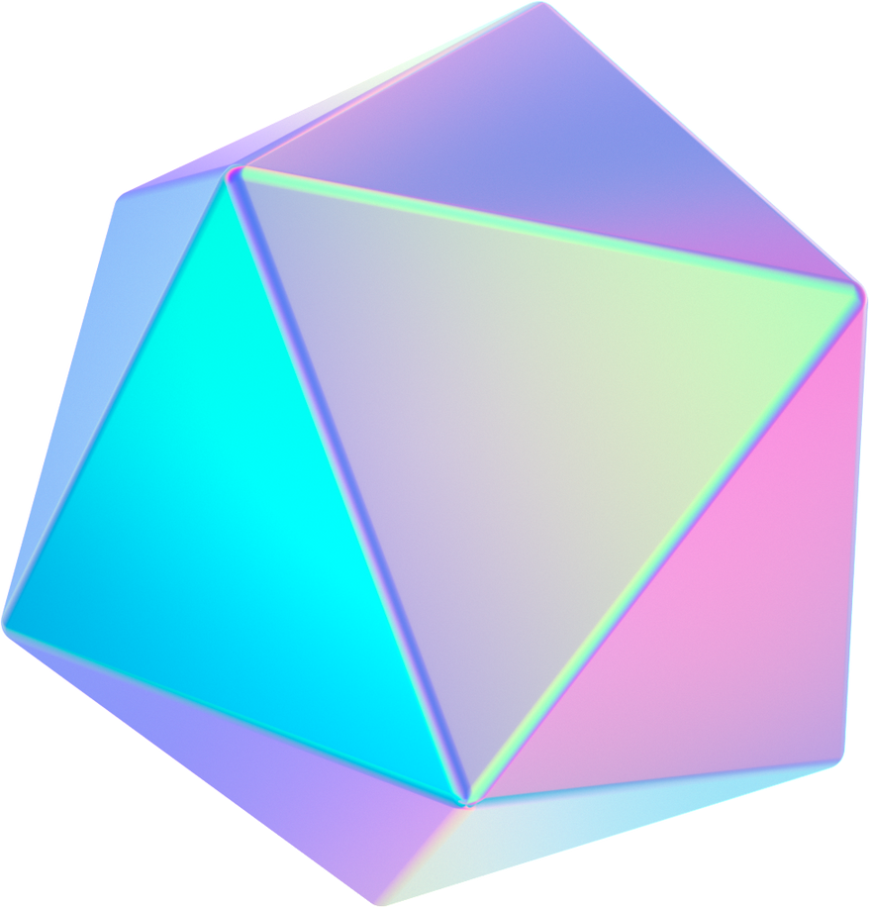

Description
Chronic Kidney Disease (CKD) is a major medical problem and can be cured if treated in the early stages. Usually, people are not aware that medical tests we take for different purposes could contain valuable information concerning kidney diseases. The information says that it helps us to measure the severity of the problem, the predicted survival of the patient after the illness, the pattern of the disease and work for curing the disease.
In todays world as we know most of the people are facing so many disease and as this can be cured if we treat people in early stages this project can use a pretrained model to predict the Chronic Kidney Disease which can help in treatments of peoples who are suffer from this disease.

Slide 3


Project Flow
Define Problem / Problem Understanding
Data Collection & Preparation
Exploratory Data Analysis
Model Building
Performance Testing & Evaluate the results
Model Deployment

Slide 4
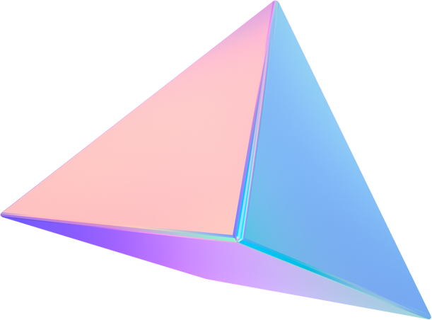

Data collection & Preparation
ML depends heavily on data. It is the most crucial aspect that makes algorithm training possible. So this section allows you to download the required dataset.
Collect the Dataset
In this project we have used .csv data. This data is downloaded from kaggle.com.
Link: https://www.kaggle.com/datasets/mansoordaku/ckdisease
Importing necessary Libraries
Data Preparation
Rename the columns
Handling missing values
Handling categorical data
Label Encoding for categorical columns
Handling Numerical data

Slide 5

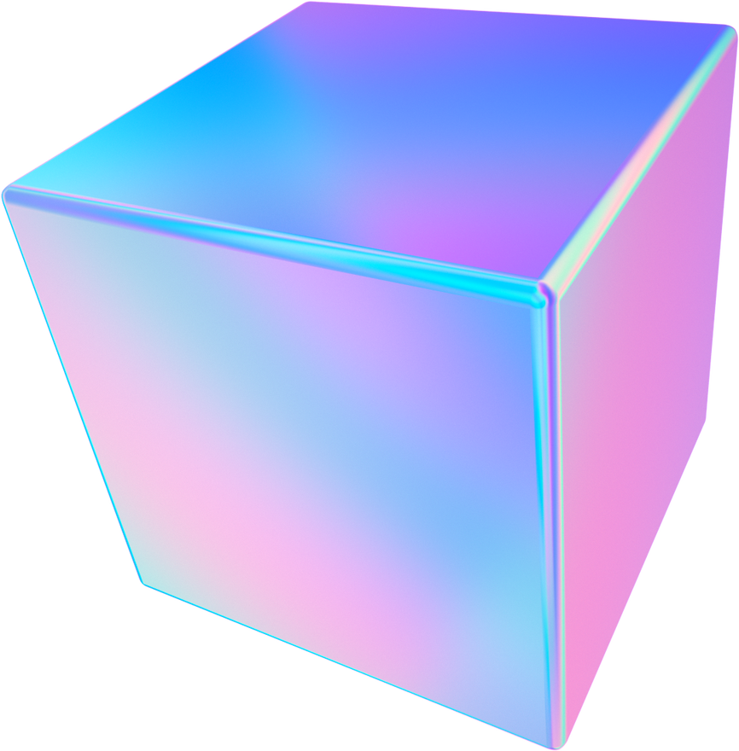
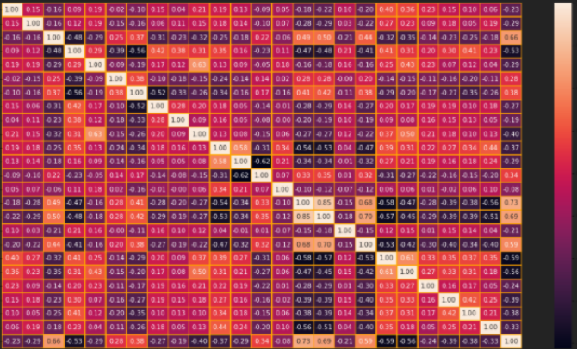
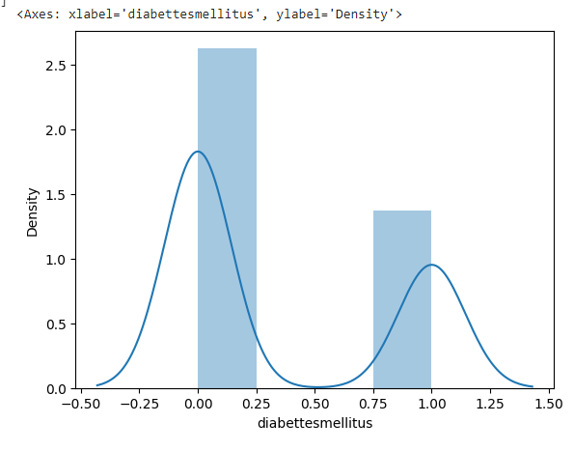
Exploratory Data Analysis
Exploratory Data Analysis (EDA) is an approach to analyze the data using visual techniques.
It is used to discover trends, patterns, or to check assumptions with the help of statistical summary and graphical representations.
Steps :
Descriptive statistical Analysis
Univariate analysis
Bivariate analysis
Multivariate analysis
Finding correlation between the independent Columns
Scaling the Data
Separate independent and dependent variable
Splitting data into train and test

Slide 6
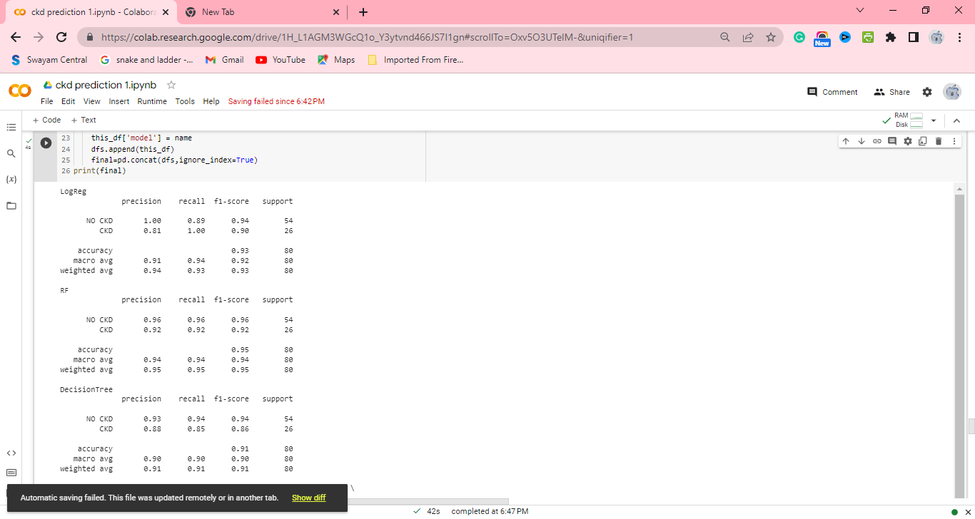
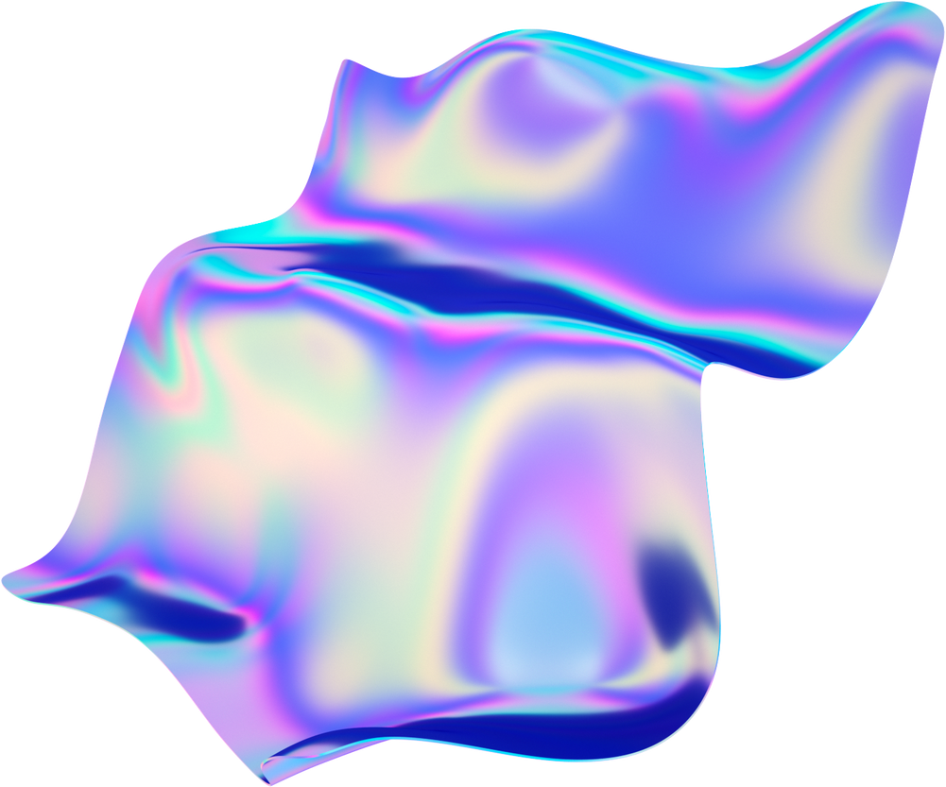
Model Building
M1
M2
M3
Random Forest model
Decision Tree Forest
Logistic Regression
A function named random Forest is created and train and test data are passed as the parameters.
Decision Tree model can be used for both classification and Regression problems, but mostly it is preferred for solving Classification problems.
Logistic regression is used for predicting the categorical dependent variable using a given set of independent variables.

Slide 7
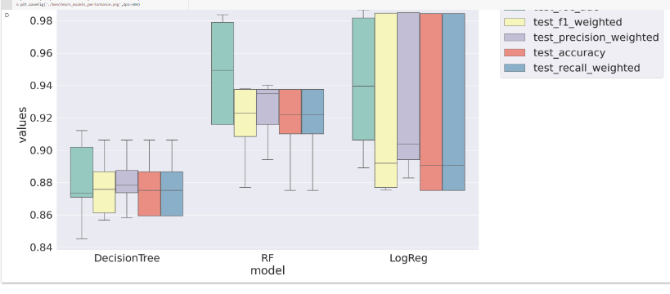
Performance Testing & Evaluate the results
Testing model with multiple evaluation metrics
Multiple evaluation metrics means evaluating the model's performance on a test set using different performance measures.
This can provide a more comprehensive
understanding of the model's strengths and weaknesses.
We are using evaluation metrics for classification tasks including accuracy, precision, recall, support and F1-score.
Among all these 3 models Logistic regression has recall 1, so we are going for logistic regression model.

Slide 8
Conclusion
CKD prediction is a critical component of CKD management, which can improve early detection, risk stratification, prognosis, and treatment response. The integration of multiple approaches and the development of personalized prediction models can enhance the accuracy and efficiency of CKD prediction.
According to the findings of the study, logistic regression can be used to predict chronic kidney disease more accurately. According to the study, their precision was 100 percent, and their accuracy was 93 percent.
This will aid in the achievement of improved outcomes as well as the accuracy and efficiency with which healthcare practitioners can anticipate kidney issues. This will enhance the dependability of the framework as well as the framework's presentation. The hope is that it would encourage people to seek early treatment for chronic renal disease and to make improvements in their lives

Slide 9
Thank You

